Slide 1

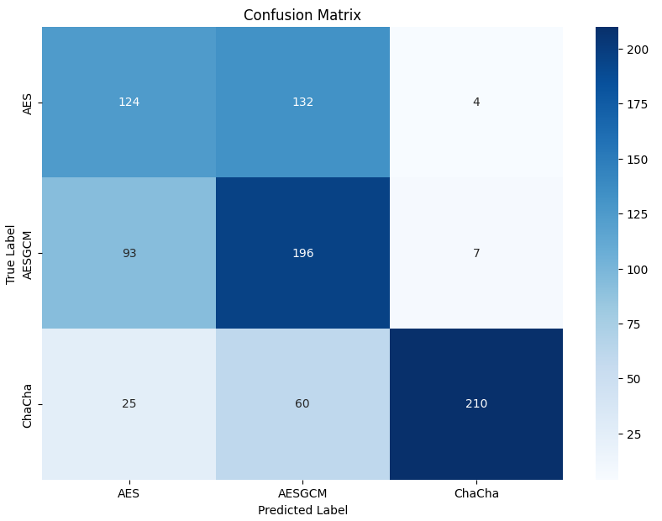
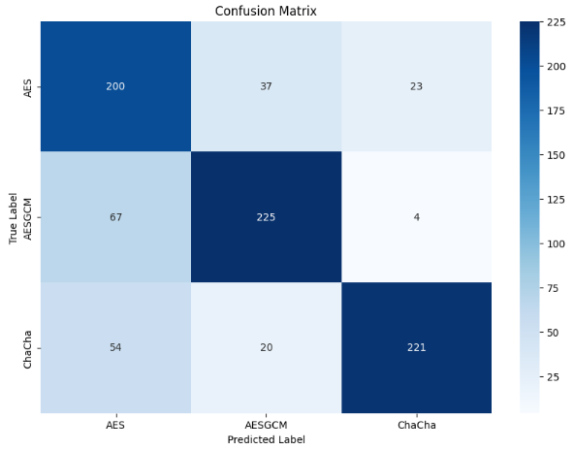
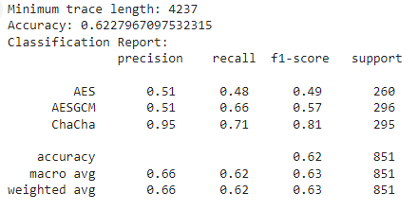
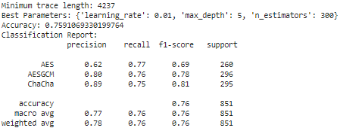
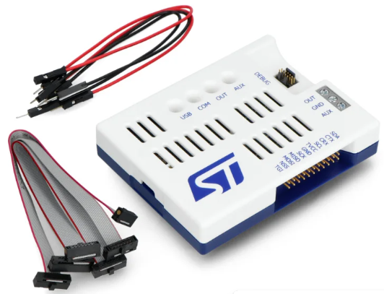
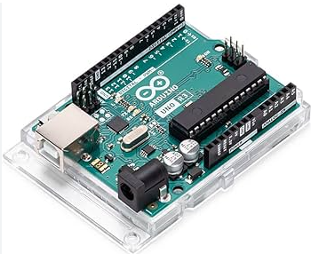
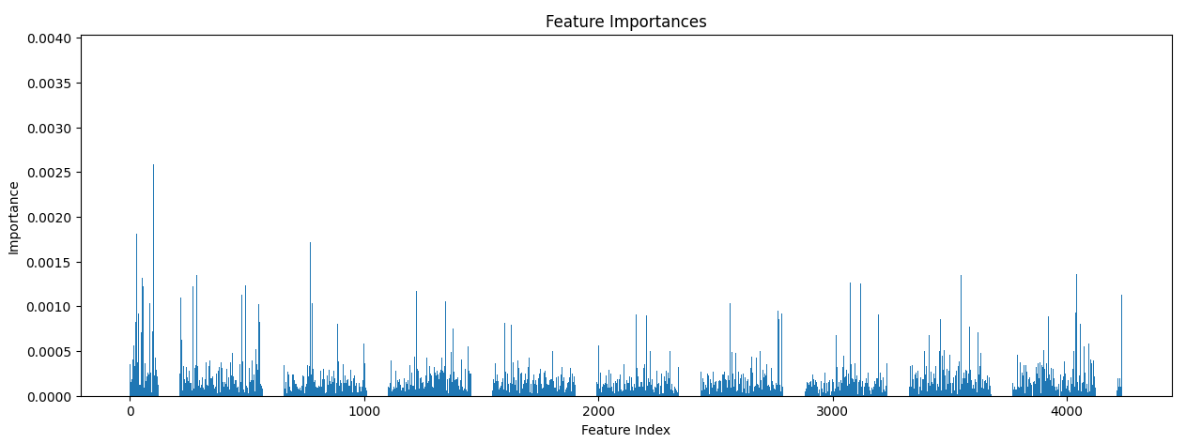
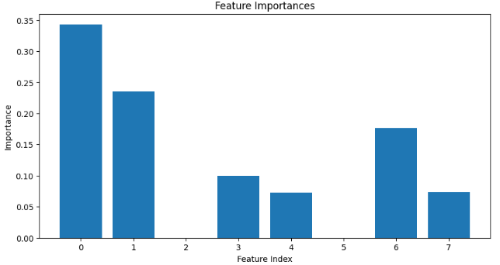




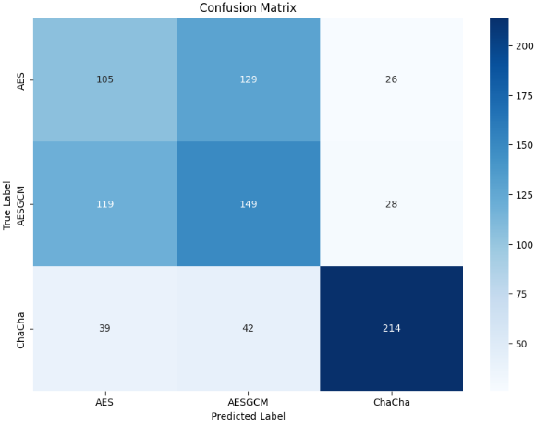
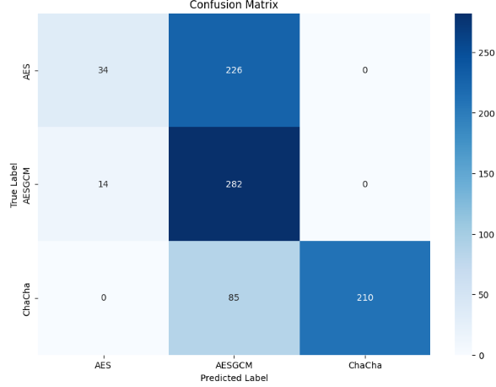
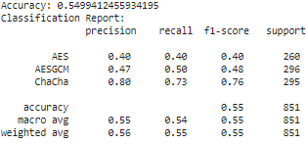
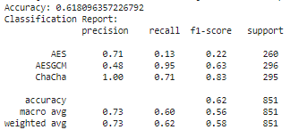
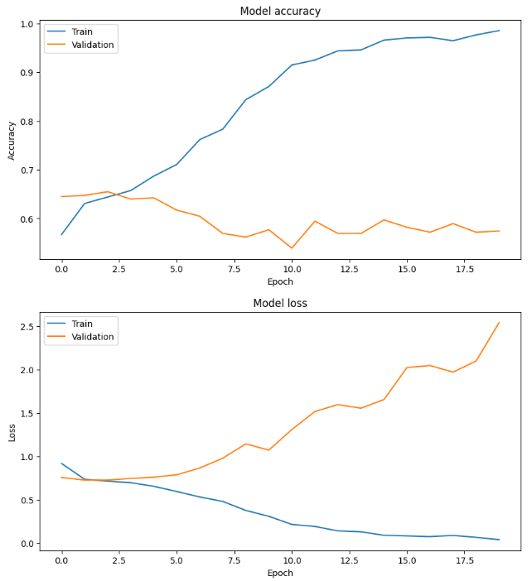
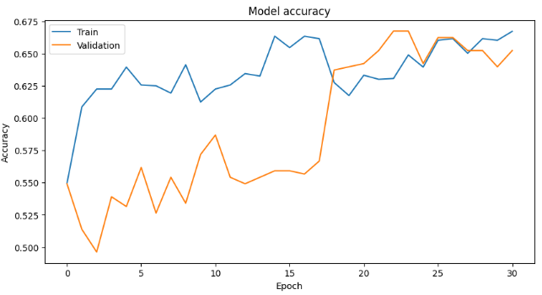
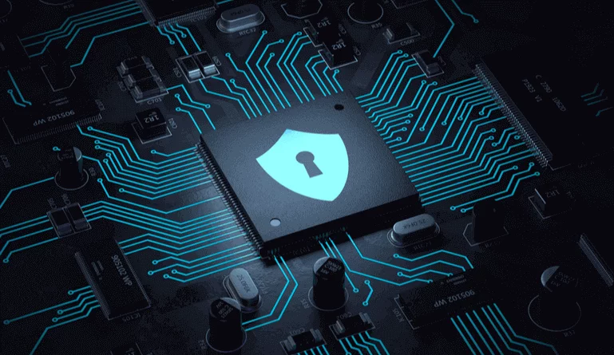
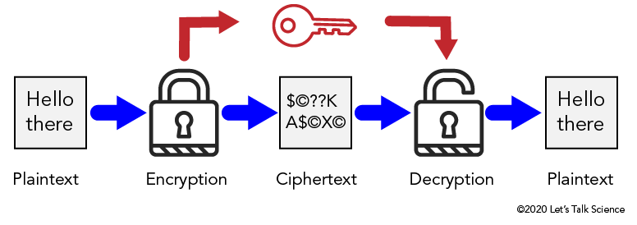
Machine Learning based Power Side-Channel Analysis using STLINK V3 Power Profiler
Donggeon Kim (Mentee), Kevin Immanuel Gubbi (Mentor)
Abstract
Materials
Results
This project investigates hardware vulnerabilities to power side-channel attacks and explores strategies to enhance hardware security. Utilizing the STLINK V3PWR power monitoring device, we establish a baseline of normal operational behavior by monitoring voltage and current parameters. We then export the power traces of each encryption. By applying machine learning to these power traces, we can identify the types of encryption. By comparing the performance of malicious and benign hardware, we reveal the dangers of hardware attacks and identify potential security vulnerabilities. Our findings contribute to the development of secure hardware, emphasizing the importance of hardware security. This comprehensive study provides valuable insights for designers and engineers, highlighting the impact of attacks on hardware performance and informing the design of robust security solutions.
By leveraging the STLINK V3PWR, we monitor voltage and current parameters to establish a baseline of normal operational behavior. The power traces of each encryption are exported and analyzed using machine learning, which helps identify the types of encryption. By comparing the performance of malicious and benign hardware, we uncover the dangers of hardware attacks and pinpoint potential security vulnerabilities. Our findings contribute to the creation of secure and safe hardware, emphasizing the importance of hardware security. This thorough study offers valuable insights for designers and engineers, shedding light on the impact of attacks on hardware performance and informing the design of robust hardware security solutions.
Arduino:
Program the encryption algorithm on the Arduino. This step involves writing and uploading the encryption code to the Arduino board using the Arduino IDE. The encryption algorithm will be used to generate encrypted data, which will later be analyzed for power consumption patterns.
STLINK-V3PWR:
Use the STLINK-V3PWR to probe the encryption process on the Arduino. This step involves connecting the STLINK-V3PWR to the Arduino and monitoring the voltage and current parameters during the encryption process. The power traces collected during this process are essential for analyzing the hardware's power consumption.
Software:
Arduino IDE: to program the Arduino
STM32CubeMonitor-Power: to use STLINK-V3PWR to probe Arduino
Google Colab: to run the machine learning to export the type of encryption
Using machine learning algorithms, we were able to learn information from the synthesized power trace dataset and classify different target encryption standards. We used 4 different machine learning models and versions. We could get the most accuracy from algorithm v3 on classification of the encryptions.
v1: Random Forest Classifier with Basic Feature Extraction
v2: Gradient Boosting Classifier with Statistical Feature Extraction
Target Device
Truncated power traces to ensure uniform length and used a Random Forest classifier to differentiate between AES, AESGCM, and ChaCha traces
Extracted statistical features from the power traces and used a Gradient Boosting Classifier with hyperparameter tuning to improve classification performance
Cryptographic
Operations
Graph to the left shows the feature importance with respect to time for all traces.
Introduction
Accuracy: 62%
Accuracy: 76%
The increasing complexity and integration of hardware systems have made them susceptible to power side-channel attacks, posing significant security threats. This project aims to investigate these vulnerabilities and explore strategies to enhance hardware security. By leveraging the STLINK V3PWR power monitoring device, we establish a baseline of normal operational behavior through the monitoring of voltage and current parameters. We then collect and analyze power traces from various encryption algorithms, applying machine learning techniques to identify encryption types and assess vulnerabilities.
Through a comprehensive comparison of the performance of cryptographic hardware, this study highlights the dangers of hardware attacks and identifies potential security weaknesses. Our findings contribute to the development of more secure crypto hardware systems, providing valuable insights for designers and engineers. This project emphasizes the critical importance of hardware security, offering robust solutions to mitigate the risks posed by power side-channel attacks.
v3: Convolutional Neural Network (CNN) for Time-Series Classification
v4: Enhanced CNN (v3) with Increased Complexity and Regularization
Methodology
Target Encryption Types: Program three different types of encryption on the Arduino: AES, ChaCha, and AES-GCM.
Conversion: Convert the data to be encrypted using each algorithm.
Power Profiler/Probing: Use the STLINK-V3PWR device to probe VCC and GND pins on the Arduino that sends the encryption data.
Exporting Power Traces: Export 1000 sample power traces for each type of encryption. These traces are necessary for analysis.
Machine Learning Analysis: We use four variants of machine learning algorithms and compare the results of all four.
Data Collection: Gather and prepare the 1000 sample power traces for each encryption type.
Tensorflow Keras: Develop machine learning code to learn from the power trace dataset and analyze the power traces.Goal is to classify the power traces based on the target device.
Analysis: Use the machine learning model to identify the type of encryption based on the power traces.
The findings from this study contribute to the development of secure and safe hardware. By providing valuable insights into the impact of power side-channel attacks on hardware performance, this research informs the design of robust hardware systems.
Implemented a CNN with convolutional, pooling, and dense layers to classify the power traces. The model included dropout and batch normalization for
regularization
Increased the complexity of the CNN by adding more convolutional layers, batch normalization, and dropout layers. Used early stopping to prevent overfitting and trained the model for more epochs to allow better convergence.
Accuracy: 55%
Accuracy: 62%
Conclusion
In conclusion, our investigation into hardware vulnerabilities using power side-channel attacks demonstrated that machine learning can effectively classify encryption types from power traces. While initial models like Random Forest and Gradient Boosting showed moderate success, the exploration of advanced architectures such as Convolutional Neural Networks highlighted the need for further refinement to achieve higher accuracy. Our findings underscore the importance of developing robust hardware security solutions to mitigate the risks of such attacks.

